Slide 1


Decoding Amazon Ratings
Data-Driven Insights into Customer Satisfaction
Presented by: [Mohamed Nour-Eldien]

Slide 2

Introduction & Project Overview
Understanding the drivers behind Amazon product ratings and satisfaction
This project aims to predict product ratings while identifying factors that drive customer satisfaction on Amazon.

Slide 3

The Business Problem
Understanding key factors influencing Amazon product ratings and seller challenges
Sellers often struggle to identify which factors truly drive high ratings on Amazon.

Slide 4

Dataset Overview
Understanding the dataset characteristics and preparation steps for analysis
This dataset includes thousands of Amazon products and essential features for modeling.

Slide 5

Dataset Preparation Insights
Key Steps in Data Cleaning
Removed currency symbols
Handled missing values
Split category features
Engineered new features

Slide 6

Modeling Approach
Exploring strategies to build a predictive model for ratings
We employed both Linear Regression and Random Forest Classifier to enhance prediction accuracy.

Slide 7
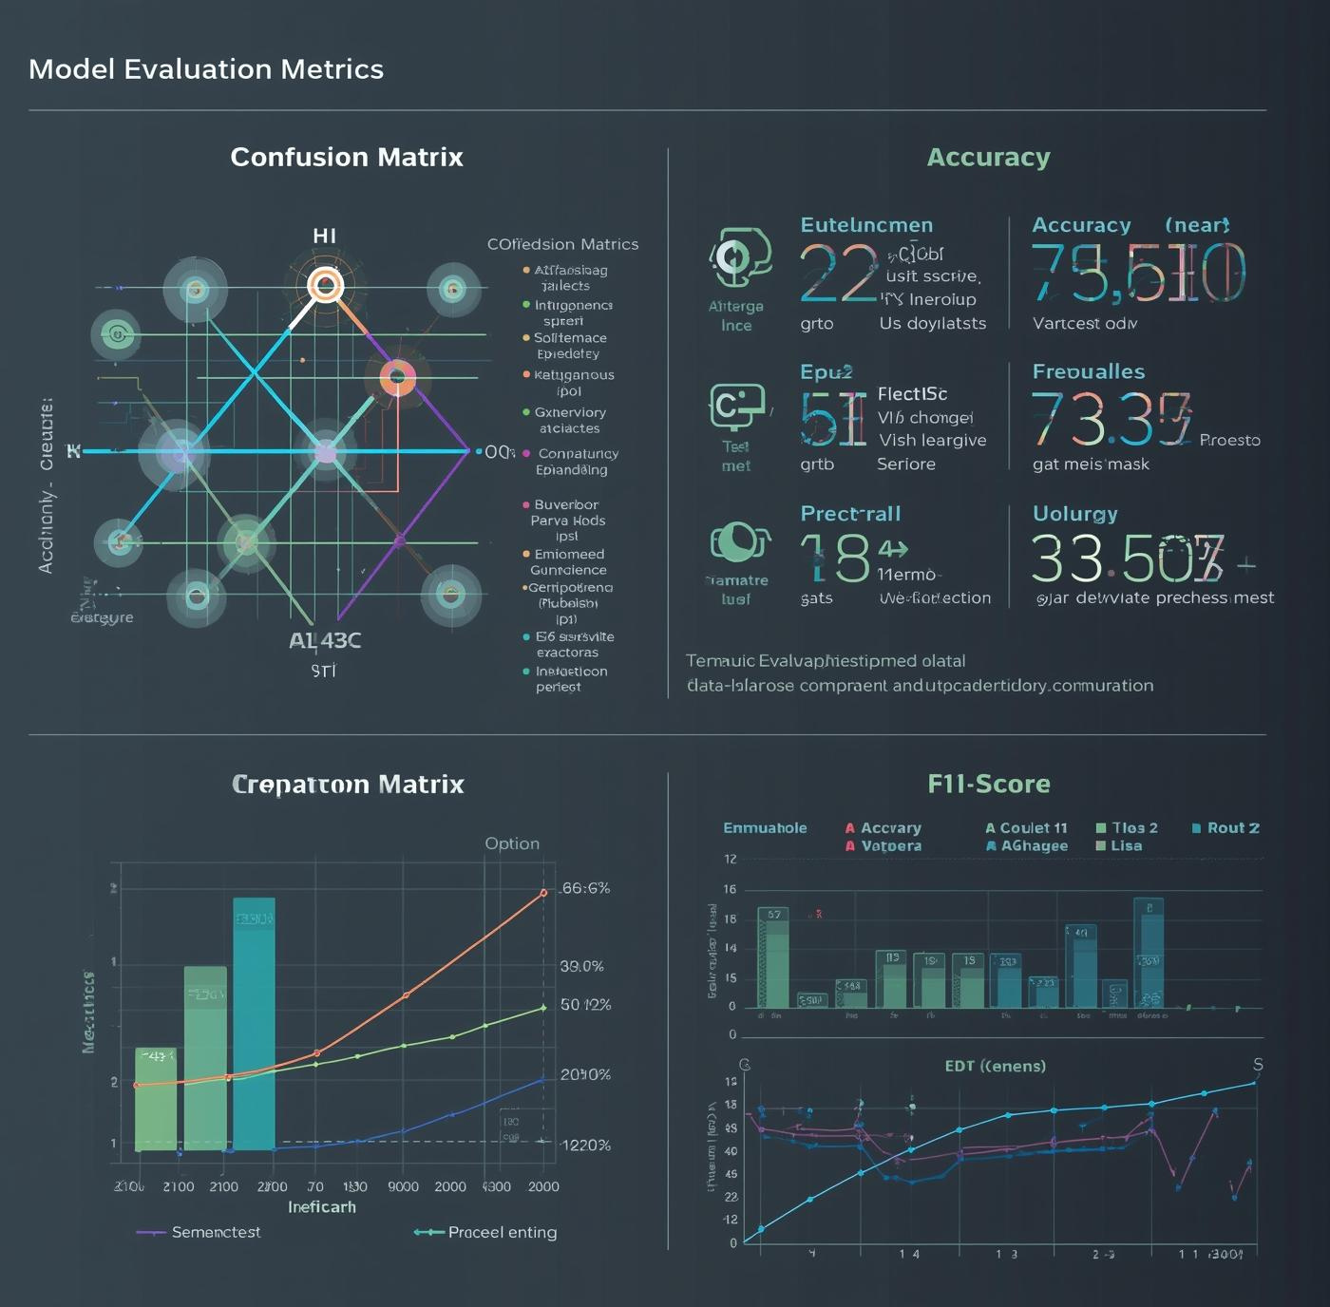
Model Evaluation
Assessing the effectiveness of our predictive modeling approach
The Random Forest model achieved an accuracy of approximately 80%, significantly outperforming the baseline model.

Slide 8
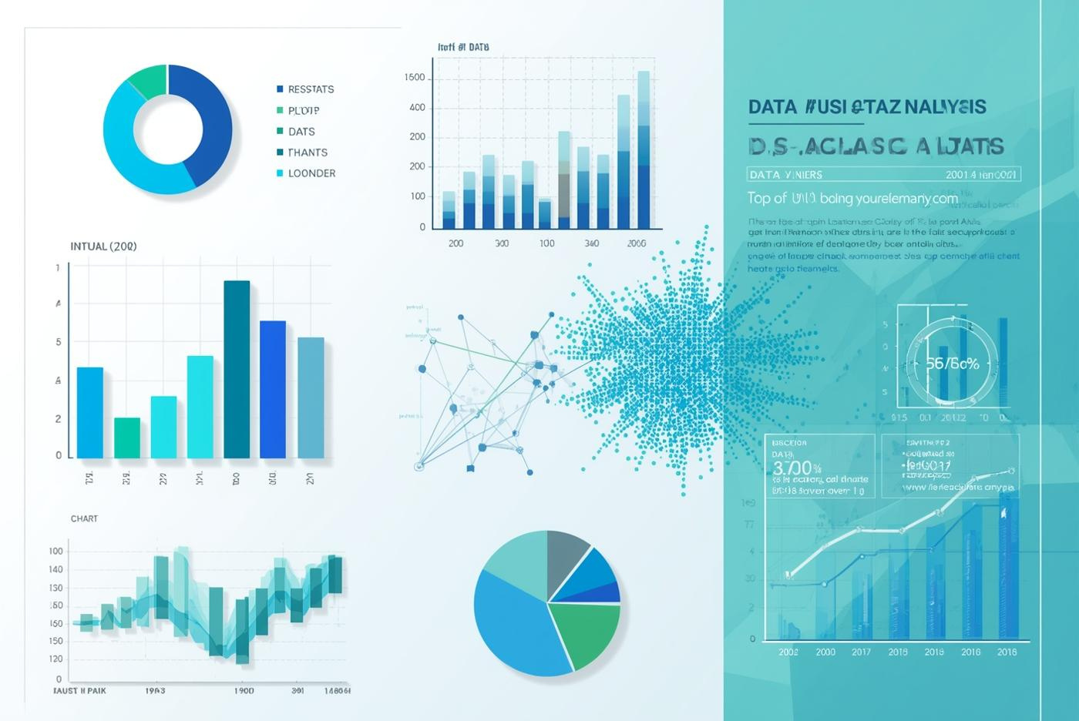
Key Insights on Features
01
Strategy
"Strategy: Amazon leverages Electronics as a 'Volume Driver' (highest product inventory and largest monetary discounts)."
02
Best Value
"Best Value: The 'Home Improvement' category offers the highest discount percentage."
03
Customer Satisfaction
"Customer Satisfaction: Ratings are highly stable around 4.0, with no underperforming categories, indicating consistent product quality regardless of the discount levels."

Slide 9
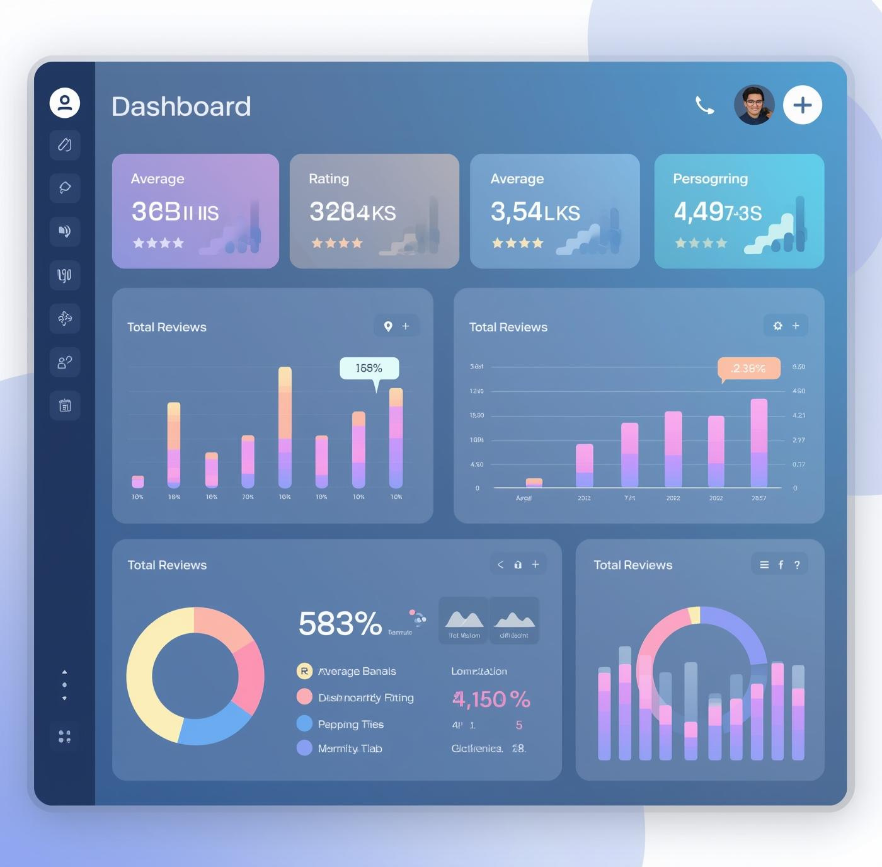
Business Implications
Translating insights into actionable strategies for Amazon sellers
Optimizing discount levels and encouraging reviews can significantly enhance customer satisfaction and ratings.

Slide 10

Conclusion & Next Steps
Summarizing insights and outlining future directions for our project
The predictive model clarifies drivers of customer satisfaction on Amazon, guiding actionable strategies.

Slide 11

Thank You
We appreciate your attention and invite any questions or feedback
Your insights and queries are valuable for further discussion

